Slide 1




Welcome to Year 1 and 2

Slide 2
Teaching Team
Butterflies
Dragonflies
Poppies
Teachers
Mrs Hazell
Mrs Maidment
Teaching Assistant
Mrs D
Teacher
Mrs Bond
Teaching Assistants
Mrs Hern
Mrs Orshi
Mrs Crook
Teacher
Miss Sweet
Teaching Assistants
Mrs Stevens
Mrs Lewis
Mrs Lee

Slide 3
Timetable
Monday
Tuesday
Wednesday
Thursday
Friday
Phonics
Phonics
Phonics
Phonics
Phonics
English
English
English
English
English
Maths
Maths
Maths
Maths
Maths
History or Geography
Science
PE
Art/Computing
PE
RE
Celebration Assembly
Music
Guided Reading
Guided Reading
PSHE
Guided Reading
Guided Reading

Slide 4
PE
Wednesday
Friday
Games
Takes place on the field weather permitting and in the hall if wet
Fundamental Skills
Takes place on the field or in the hall
a;
Jewellery must not be worn and hair must be tied back

Slide 5


Whole School Expectations

Slide 6
Expectations
We aim to develop successful learners, confident indivduals and responsible citizens
The curriculum is challenging for both year groups but it is fun and exciting
Throughout the year we prepare Year 2 for their transition to junior school, aiming to make them more independent in their learning, behaviour and attitude.
Year 2 will still have opportunities to shine througout the year - remembrance assembly, Christmas play and an end of year leavers assembly.

Slide 7
Reminders
  Please bring a small fruit snack to have at morning playtime. This needs to be in a separate box to their lunchbox if they have a packed lunch as we take them outside to eat.
  Grapes must be cut in half.
  Any changes to lunch time arrangements need to be communicated to the school office
  PE days will now be Wednesday and Friday from next week
  The weekly timetable will be emailed out on a Monday
  No nuts or nut products are allowed at school in lunchboxes or after school club snacks

Slide 8
Year 1 and 2 Curriculum
Phonics: Year 1 recap Phase 3 and then begin Phase 5
Year 2 recap phase 5 then begin bridge to spelling and spelling
rules
Maths: Year 1 and 2 follow their respective year group curriculum
Our KS1 curriculum for English and foundation subjects is a rolling program - Cycle A and Cycle B.
Assessments: Year 1 phonics screening June 2027 and any year 2 resits
Year 2 end of key stage teacher assessments in June 2027

Slide 9
Maths
Year 1 and Year 2
  Follow mastery maths approach which aims to develop both mathematical fluency and the ability to problem solve.
  Lessons include - sticky learning, lots of interacting, questioning, short tasks, explanations, discussions enabling the children to think, reason and apply thier knowledge to solve problems.
  Additional 10 mins daily number fluency sessions
  During the Autumn term Year 2 will start regular mental maths tests on a Friday
  If additional support is needed we use a programme called Numberstacks

Slide 10
Maths
How can you help?
  Encourage opportunities to tell the time
  Encourage opportunities for recognising and counting coins. Finding amounts and calculating change when shopping
  Playing games that involve counting in different amounts forwards and backwards
  Identify, weigh or measure quantities in the kitchen or in recipes.

Slide 11
Writing
Year 1 and Year 2
  Follow Talk for Writing approach and aim to develop confident and independent writers
  Our texts covered a range of genres including fiction, non fiction and poetry
  Children are taught handwriting in separate daily lessons and SPAG within our English lessons

Slide 12
Writing
How can you help?
  Practise our common exception words. We regularly assess the spelling and will send home words that your children need to practise
  Encouraging opportunities to practise writing - birthday cards, shopping lists, letters to family, stories or poems. Ask your child to check their spelling and punctuation.
  Encourage the use of a dictionary to check spellings.
  Remembering that good readers become good writers! Identify good writing features when reading (eg vocabulary, punctutation, sentence structure and punctuation).

Slide 13

Reading
We have a phonetically decodable reading scheme.
Inside the front cover you will find:
  Phonemes to practise
  Words to blend together
  Common exception words to practise
  Words that you can discuss with your child.
Inside the back cover you will find:
  Vocabulary to practise
  Comprehension questions to ask
Books go up to Phase 5 then children move onto fluency chapter books.

Slide 14
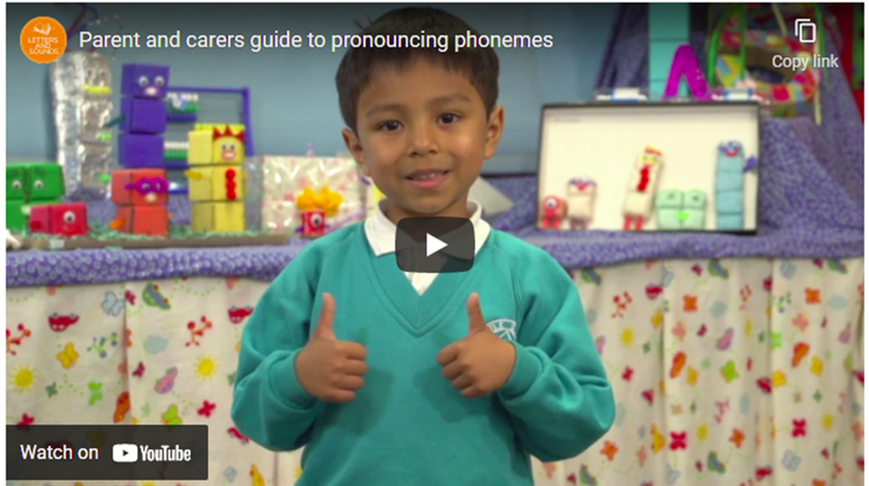
Reading
If you are unsure of the pronunciations of any of the phonemes please do ask us or watch the pronunciation video.
https://youtu.be/TTe5_EeOBHQ

Slide 15
Reading
Year 1 and Year 2
  Children read a minimum of 3 times a week.
  Reading folders need to be bought into school everyday
  Our first reading group is at 8.50am
  Children have a wide range of opportunities to read throughout the day.
  Current guidance is that children should be reading their books with 90% fluency and that repetition of books will aid this.
  We will continue to monitor and assess the childrens phoneme and tricky word knowledge and will progress them onto the next reading level when they are secure and have the correct level of fluency
  Children will also bring home a sharing book for you to enjoy together.

Slide 16
Reading
How can you help?
  Listen to your child everyday.
  Enjoy stories together - reading to your children is just as important as them reading to you.
  Talk about stories - plot, characters, feelings and predicting what might happened next.
  Look up definitions of words together
  All reading is invaluable - it doesn’t have to just be stories. Anything from - newspapers, magazines, poems, football programs and TV guides

Slide 17
Homework
Phonics
Weekly sheet Friday
Sounds and words covered that week. Please take them out and practise with your child. This will be sent home on a Friday.
Reading
Daily 15 mins
Sharing a reading book, talking about what they have read and asking questions. Encourage your child to use their skills of deductiona and inference.
Handwriting
Weekly sheet
Friday
Practising correct letter formation in preparatin for using joined handwriting.
Maths
Weekly sheet
Friday
Shared activity supporting and consolidating topics taught in class. Year 2 mental maths tests will be sent home in October, these wil be assessed in class on a Friday.

Slide 18
Curriculum Enhancement
During the year children will participate in a variety of activities to enhance the National Curriculum. These will include:
  Library skills
  External trip - The Living Rainforest June 2027
  Drama workshops
  Themed weeks - Feeling Good Week, Book Week, Future Selves Week
  Music and fitness workshops
  Football skills festival with other schools
  Avery Care Home singing

Slide 19
Extra Fun !
Physifun Bag
Bedtime Book bag
Each week a child will be chosen to take home a Physifun bag. These bags will give the childrenthe chance to try some different games at home with their family, with all the equipment provided in the bags. Please record what you do as the children will share in the class
The children will have the opportunity to take home a Bedtime book Bag. Share a book with your children whilst they snuggle up with our reading owl and a yummy hot chocolate!
Please record which was their favourite as the children will share in the class

Slide 20
Voulunteers
Friends of Trumps Green Committee - are looking for a co-chair and some other vacancies. If anyone is interested in helping please email the school office. The Friends are vital in supporting our school. Thier fund raising enables us to purchase additional resources and fund extra curricular activities linked to our learning. Without them none of the exciting extras would go ahead.
From time to time we ask for volunteers to help with:
  walking children to otherside activites - woods, library, St Ann’s, Avery Care Home
  Tending flowerbeds outside the classrooms
  Providing paper plates, tissues, hand gel and soap when stocks get low

Slide 21

THANK YOU!
All the children have settled in well and we are looking forward to working with you and your children

