Slide 1


Reception Information Meeting
Üdvözöljük
Ласкаво просимо
September 2024
Hoşgeldiniz
bi xêr hatî
Bine ati venit
خوش آمدی
أهلا بك
ברוך הבא

Slide 2

Who’s who
Bumblebees
Class teacher
Mrs Miracco ​
Teaching assistant ​
Miss Baker
Ladybirds
Class teachers​
Mrs Bharakhda (Monday to Thursday) & Mrs Moore (Friday)
Teaching assistant
Miss Cleaver (Tuesday to Thursday), Mrs Lewis (Monday)

Slide 3
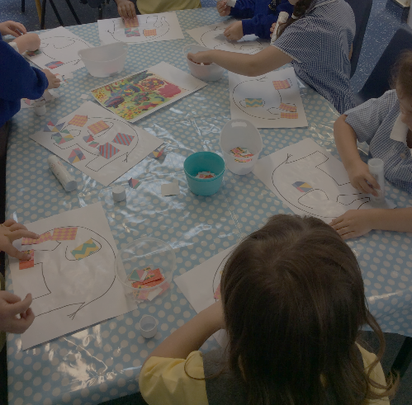
An example of our day
Arrival time - put belongings away (water bottle, book bag, snack and coat) no juice or squash please
Phonics – followed by a variety of learning opportunities inside and outside with a mix of adult and child led learning including reading sessions
Morning snack time – fruit or vegetables only in a named container
Maths – Mastering Number Scheme
Continue with focus learning time
Lunchtime and playtime
Daily handwriting
Afternoon registration followed by carpet time followed by a variety of learning opportunities inside and outside with a mix of adult and child led learning
Afternoon school fruit snack and school milk (Cool Milk)
Story time and home time

Slide 4
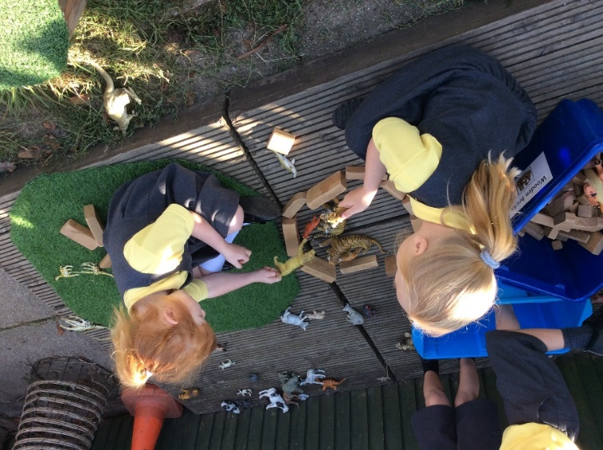
Our focus for this half term
Getting to know each other and our school, learning how to interact and play
Looking after our belongings
Keeping safe including hand washing and using tissues
Becoming independent in school – cutting food, managing the toilet independently, opening book bag and putting things in it, putting coat on and taking jumpers off
Proud Promises – To be safe, to be ready, to be kind and respectful.
Behaviour – school appropriate e.g. eyes looking, ears listening, sitting on the carpet for whole class learning
Reception Baseline Assessment

Slide 5
What does your child need each day
Filled water bottle, only water please
Book bag – with reading books and diary
Coat
Sun hat
Gloves when the weather gets colder
A pair of wellies to leave in school

Slide 6
Prime areas of learning
Communication and language |  | Personal, social and emotional development |  |  | Physical development
Listening attention and understanding | Speaking | Self-regulation | Managing self | Building relationships | Gross motor skills | Fine motor skills
Specific areas of learning
Literacy |  |  | Mathematics |  | Understanding the world |  |  | Expressive arts and design
Comprehension | Word reading | Writing | Number | Numerical patterns | Past and present | People, cultures and communities | The natural world | Creating with materials | Being imaginative and expressive

Slide 7



The EYFS curriculum (2021)
Further information can be found
https://www.gov.uk/government/publications/early-years-foundation-stage-framework--2
https://www.gov.uk/government/publications/development-matters--2/development-matters#seven-key-features-of-effective-practice

Slide 8
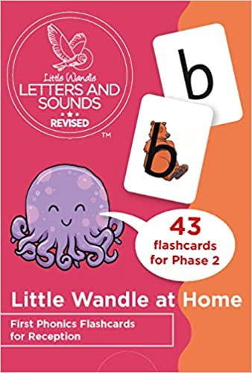
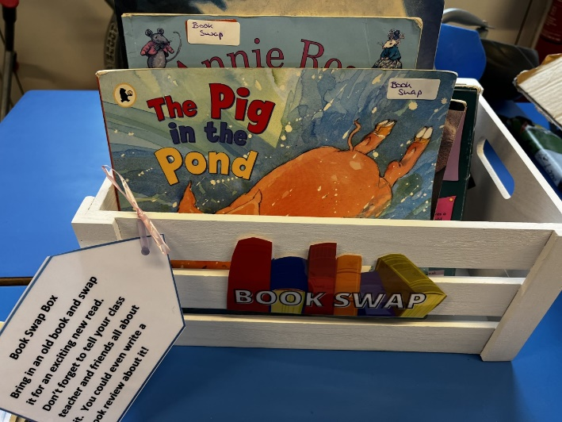
Reading and phonics – Little Wandle
Little Wandle Rhyme time sessions
Phonics teaching will start next week in school. We will be learning 4 phonemes each week
Phonics homework - New phonemes with the grapheme, mnemonic, pronunciation phrase and formation phrase each week plus the home learning sheet
Decoding books to follow. These will be changed once a week and a new book will come home each Friday. Please return the old book on a Thursday. Yellow Diaries to be brought in every day.
Reading meeting being organised by Mrs Hazell our English lead on Tuesday 23rd September at 9am

Slide 9
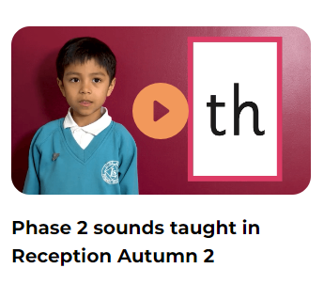
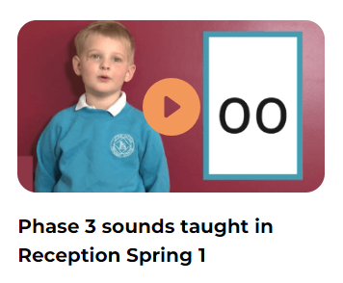
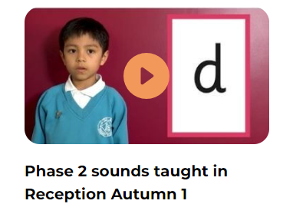
Phonics
https://www.littlewandlelettersandsounds.org.uk/resources/for-parents/

Slide 10

PE days
This half term
Please can the children come into school on Monday dressed in their PE kit. No jewellery to be worn unless it is for religious purposes.
We will add an extra PE day after half term (Thursday)

Slide 11
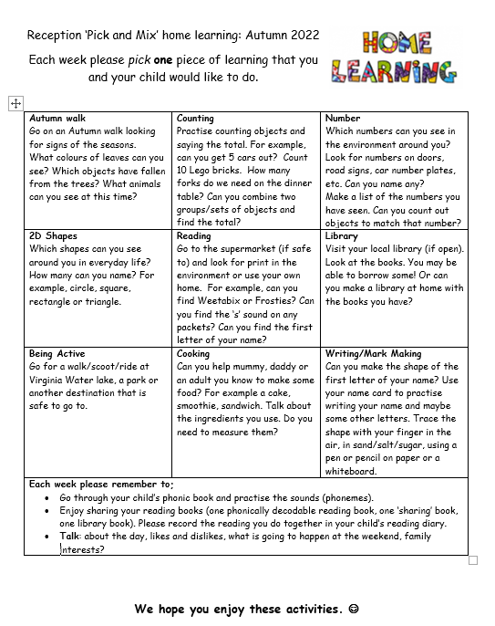
Home learning
‘Pick and mix grid’
Phonic weekly grapheme sheet and
Home learning sheet
Reading book, diary and sharing
book (later this half term).
Please keep reading diary in your
child’s bag everyday
Our library day is a Monday
WOW Moments

Slide 12

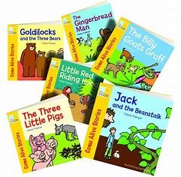
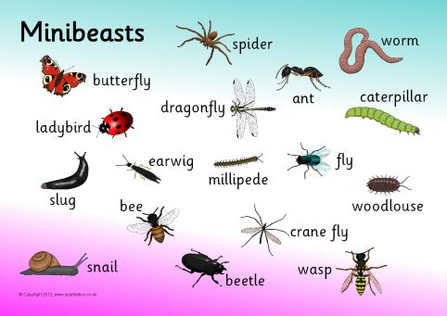
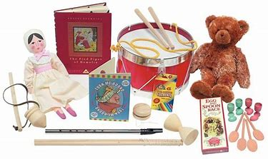
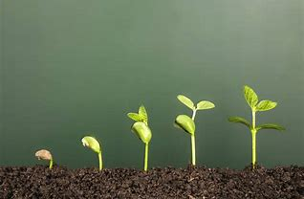
The curriculum
This years topics
Autumn 1 | Autumn 2
Me and my school | Celebrations
Spring 1 | Spring 2
Toys | Traditional Tales
Summer 1 | Summer 2
Minibeasts | Plants, growth and change

Slide 13
FOTG (Friends of Trumps Green)
Run by a committee of parent volunteers, who regularly meet with Miss Morris to discuss initiatives which raise money for the school.
All parents automatically become Friends of Trumps Green
There are opportunities to be a part of the committee or volunteer to support with various projects.
Monies raised go towards curriculum enhancements

