Slide 1






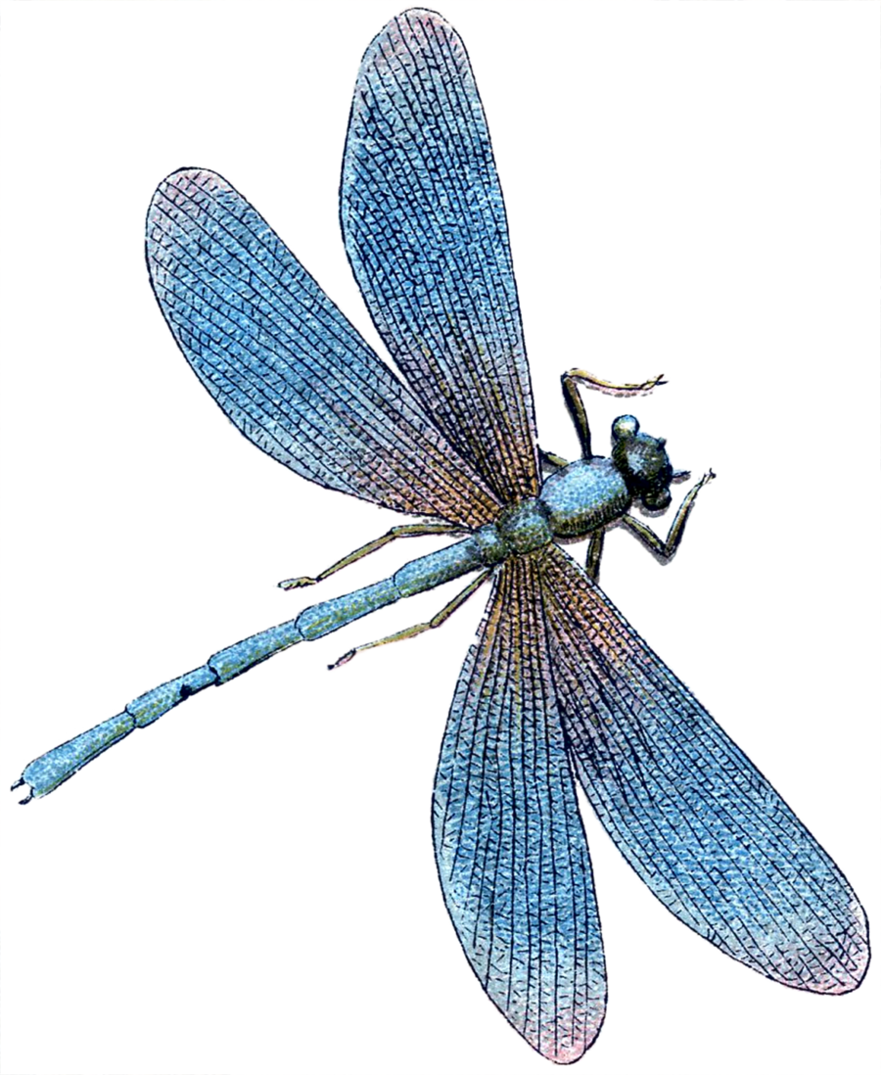



1 – 3.30 PM
SATURDAY 19TH JULY
SUMMER FAIR
BBQ & DRINKS
Facepainting
SWEETS & CAKES
TOMBOLAS
FUN & Games
Raffle
STALLS
& LOTS more!

