Slide 1



Welcome to Year 2
Thursday 12th September 2024

Slide 2
Year 2 Teaching Team
Butterflies
Teachers
Mrs Morriss/Mrs Maidment
Teaching Assistant
Mrs Gill / Mrs Crook
LSA
Mrs Orshi/Mrs Lewis
Dragonflies
Teacher
Mrs Bond
Teaching Assistant
Mrs Hern /Mrs Kim

Slide 3
Timetable
Mon | Tues | Wed | Thurs | Fri
Phonics | Phonics | Phonics | Phonics | Phonics
English | English | English | English | English
Maths | Maths | Maths | Maths | Maths
History/Geography | PSHE | RE | Science | Art
 | Music | PE | Celebration Assembly | Computing
Guided Reading | Guided Reading | Guided Reading | Guided Reading | Guided Reading

Slide 4
PE in Year 2
Day | What | Where | Kit Required
Wednesday | Games | Field (weather permitting hall if wet) | White polo shirt Blue shorts or jogging bottoms Trainers
Friday | Fundamental Skills | Hall/Field | White polo shirt Blue shorts or jogging bottoms Bare feet
Jewellery must not be worn and hair must be tied back

Slide 5

Whole School Expectations

Slide 6
Year 2 Expectations
  The Year 2 curriculum is challenging and as such we have high expectations
  If your child did not pass the phonics screening in Year 1, they will resit it in the Summer term.
  Year 2 is an end of Key Stage assessment year
  Throughout the year we prepare them for their transition to junior school so we aim to make them more independent in their learning, behaviour and attitude. We want them to be happy in school and excited to learn.
  We aim to develop successful learners, confident individuals and responsible citizens.

Slide 7
Maths
  We follow a mastery math’s approach which aims to develop both mathematical fluency and the ability to problem solve and reason.
  Our math’s sessions include mental math starters, number fluency and problem solving
  We have 10 minute daily number fluency sessions
  During the Autumn term we will start regular mental math’s tests
  If any additional support is needed we use a programme called Numberstacks

Slide 8
Maths
You can support your child with their math’s by:
  Playing mental math’s games including counting in different amounts forwards and backwards
  Encourage opportunities for telling the time
  Encourage opportunities for counting coins and money eg finding amounts or calculating change when shopping
  Identify, weigh or measure quantities and amounts in the kitchen or in recipes. Looking for 2D and 3D shapes around the home.
  Play times table games (Times Table Rock Stars and Squeebles are good apps)

Slide 9
Writing
  We follow the Talk for Writing approach to writing and aim to develop confident and independent writers
  Our texts cover a range of genres including fiction, non fiction and poetry
  Children are taught handwriting in separate daily lessons and SPAG within our English lessons

Slide 10
English
You can support your child with their writing by:
  Practising our common exception word lists. We regular assess the spelling of these and will send home words that your children need to learn
  Encouraging opportunities for writing, such as letters to family or friends, shopping lists, notes or reminders, stories or poems. Ask you child to check their spelling and punctuation
  Writing together - be a good role model for writing
  Encouraging the use of dictionary to check spelling
  Remembering that good readers become good writers! Identify good writing features when reading (eg vocabulary, punctuation, sentence structure)

Slide 11
Reading
  Children on decodable books will read the book 3 times at school before they bring it home. Those children who have moved on from decodable books will read twice a week in our daily guided reading sessions.
  The children have a wide range of opportunities to read throughout the day
  Current guidance is that children should be reading their books with 90% fluency and that repetition of books will aid this. This means that children will be read within their reading level until they are secure in their knowledge of the next phonemes and tricky words. We will continue to monitor and assess the children’s phoneme and tricky word knowledge and will progress them onto the next reading level when they are secure and have the correct level of fluency.
  Children will be issued with new books on a Friday and must bring them into school every day. Please continue to fill in your child’s reading diary, as it is important to have an insight into how they read at home
  Children will also bring home a sharing book and a library book for you to share and enjoy together.

Slide 12
Reading - continued
  You can support your child with their reading by:
  Listening to your child every day
  Enjoying stories together - reading to your child is just as important as them reading to you
  Talk about the story - before, during and after. Discuss the plot, characters, feelings, actions, how it makes you feel, predict what might happen and encourage your child to have their own opinions
  Look up definitions of words together - you could use a dictionary, the internet or an app on a phone or tablet
  All reading is invaluable- it doesn’t have to just be stories. Reading can involve anything from fiction, non-fiction, poetry, newspapers. magazines, football programs and TV guides
  use the swap box whenever you want. These are under the covered areas for both classes to use. Bring an old book and swap it for an exciting new read!

Slide 13

Reading - continued
We are lucy enough to have a phonetically decodable reading scheme.
Inside the front cover you will find:
  Phonemes to practise
  Words to blend together
  Common exception words to practise
  Words that you can discuss the meaning off
Inside the back cover you will find:
  Vocabulary to practise
  Comprehension questions to ask
These books go up to turquoise level and then children will move on to banded books

Slide 14
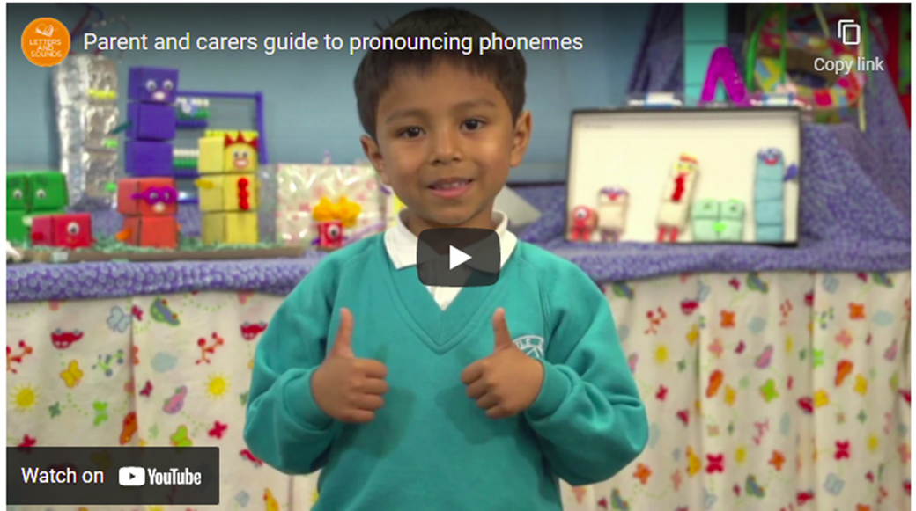
Reading - continued
If you are unsure of the pronunciations of any of the phonemes please do ask us or watch the pronunciation video.
https://youtu.be/TTe5_EeOBHQ

Slide 15
Homework
Speaking and listening | Daily | Talk to your child and ask questions about their day at school. Ask your child to share 3 facts they have learnt
Reading | Daily 15 minutes | Sharing a reading book, talking about what they have read, asking questions. Encourage your child to use their skills of inference and deduction
Handwriting | Weekly 10 minutes | Practising correct letter formation in preparation for using joined hand writing. This will be sent home on a Friday
Maths | Weekly 20 minutes | A shared activity supporting and consolidating topics taught in class. This will be sent home on a Friday. Times table activities will be sent home after at the end of September. These will be assessed in class

Slide 16
Curriculum Enhancement
During the year your children will participate in a variety of activities to enhance the National Curriculum. These will include:
  Library skills
  Dance Woking
  External trip to Painshill Park
  Drama workshops and theatre groups
  Feeling Good Week, Enrichment week, Book Week
  Fitness workshops
  Specialist visitors - The Bug Man, Dr Metcalfe, The Puzzle Company

Slide 17
Extra Fun !
Each week a child will be chosen to take home a Physifun Bag. These bags will give the children the chance to try some different games at home with their family, with all the equipment provided in the bags. Please record what you do as the children will share in the class.
The children will also have the opportunity to take home a Bedtime Book Bag. Share a book with your children whilst they snuggle up with our reading owls and drink of yummy hot chocolate

Slide 18
We are looking forward to working with you and your children

