Slide 1


Welcome to Year 1

Slide 2
Sunflowers Class
KA/ES
Miss Adams
Class Teacher
Miss Cleaver
Teaching Assistant
Poppies Class
Miss Sweet
Class Teacher
Mrs Stevens
Teaching Assistant
Mrs Augterson
Class Teacher
Mrs Lee
Teaching Assistant

Slide 3


Whole school expectations

Slide 4
Year 1
KA
As your children begin Key Stage 1 we aim to make the transition from Reception and the EYFS curriculum as smooth as we can.
The children will begin to work more independently in Year 1, but will still be able to access continuous provision to enhance their learning opportunities.
As we progress through the year we aim to increase the children’s independence in readiness for Year 2.

Slide 5
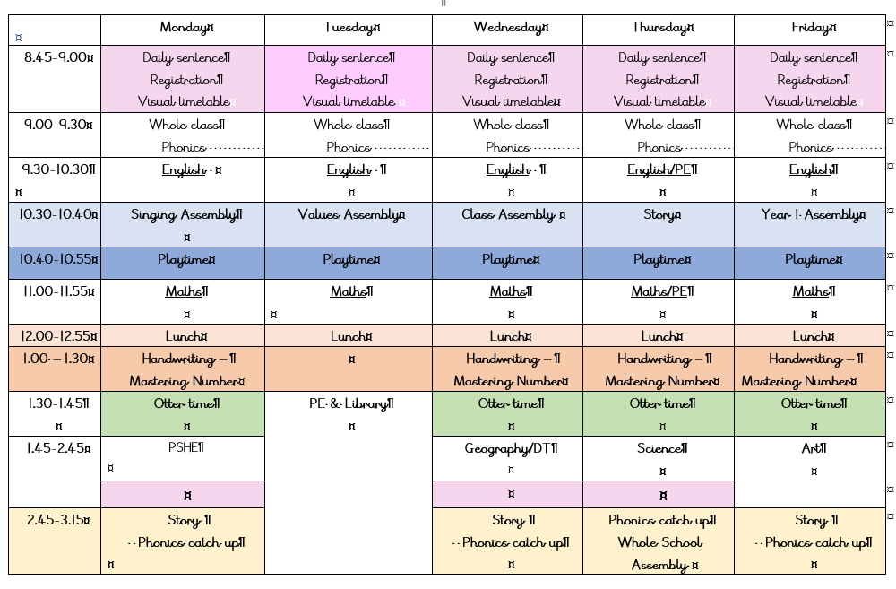
Year 1 timetable

Slide 6
PE in Year 1
KA
Day | What | Where | Kit Required
Tuesday(pm) | Games | Field (weather permitting, hall if wet) | White polo shirt Blue shorts or jogging bottoms Trainers
Thursday(am) | Dance/Gym | Hall | White polo shirt Blue shorts or Trainers jogging bottoms can be worn but please put shorts underneath.
Please come to school wearing your PE kit on Tuesday and Thursday.

Slide 7
Phonics
KA
Phonics are a essential tool to help enable your children to learn to read. We follow a scheme called Little Wandle which starts in Reception and continues throughout KS1.
During the beginning of the Autumn term we briefly revisit Phase 2, 3, and 4 that were learnt in Reception.
We then progress to phase 5.
Your child will be taught phonics on a daily basis and sheets will be sent home on a Friday that support the phonics taught that week.
https://www.littlewandlelettersandsounds.org.uk/resources/for-parents/
Phonics Screening should take place in June 2025

Slide 8
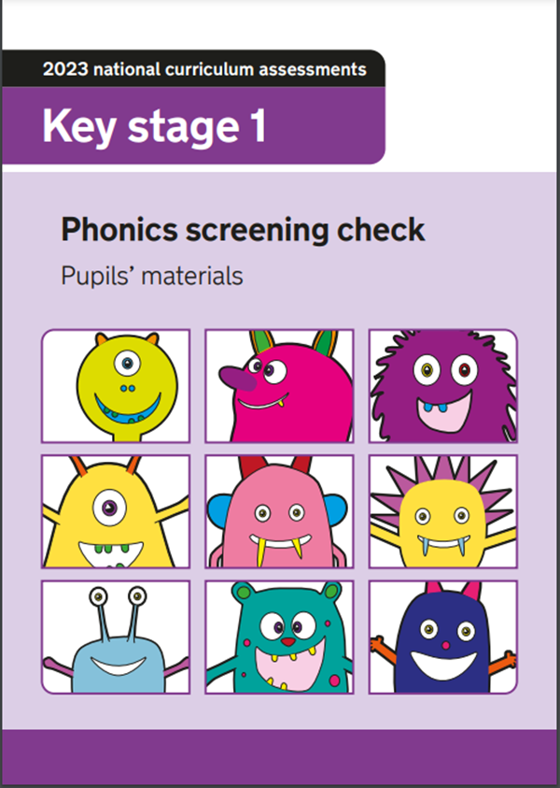
Phonics Screening
KA
Each child is individually assessed by their class teacher.
They have to read a combination of 40 real and nonsense words from the phonics they have learnt in Reception and Year 1.
The pass rate is normally 32 and if your child is unable to achieve this mark they will resit the assessment in Year 2.
Although this is a government required assessment we will endeavour to make this as child friendly and ‘untest like’ as possible.

Slide 9
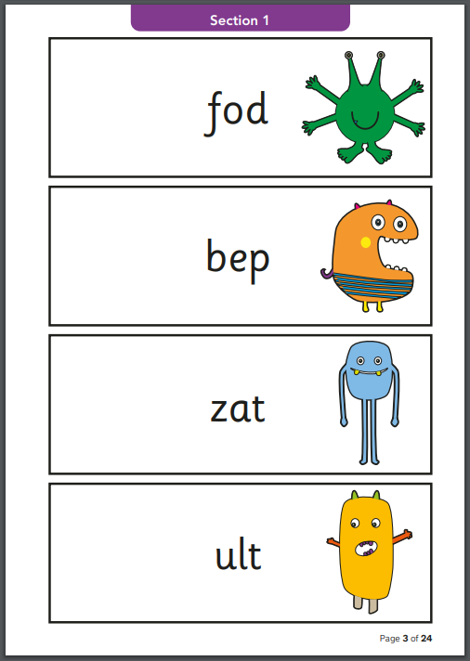
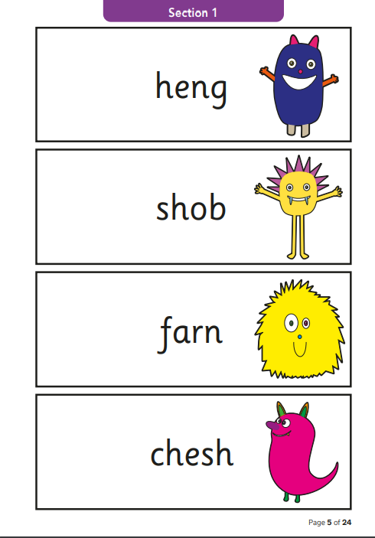
KA

Slide 10
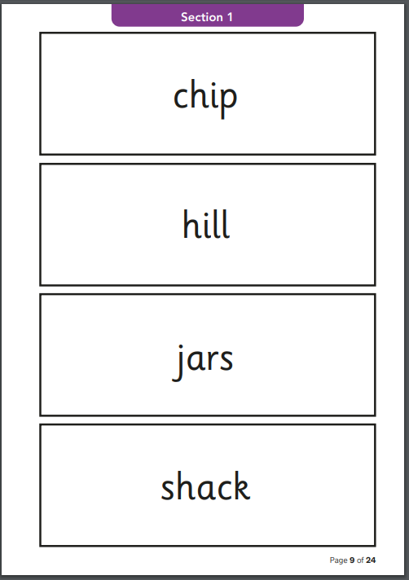
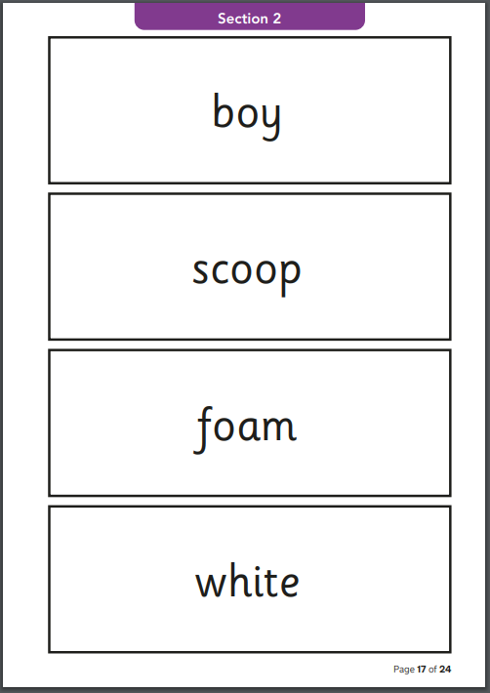
KA

Slide 11
Reading
KA
Children will read three times a week, at least once a week to the class teacher in our guided reading groups
The children have a wide range of opportunities to read through out the day.
We regularly assess the children’s reading
You can support your child with their reading by:
Listening to your child every day, please fill in their reading diary.
Enjoying stories together – reading stories to your child is equally as important as listening to your child read.
All reading is valuable – it doesn’t have to be just stories. Reading can involve anything from fiction and non-fiction, poetry, newspapers, magazines, football programmes, TV guides.
Visit the local library

Slide 12
Writing
KA
We follow the Talk for Writing approach to writing and aim to develop confident and independent writers.
Our texts cover a range of genres including fiction, non-fiction and poetry.
Children are taught handwriting in separate lessons and SPAG (spelling, punctuation and grammar) within our English lessons.
You can support your child with their writing by:
Practising our Common Exception Word lists.
Encouraging opportunities for writing, such as letters to family or friends, shopping lists, notes or reminders, stories or poems.

Slide 13
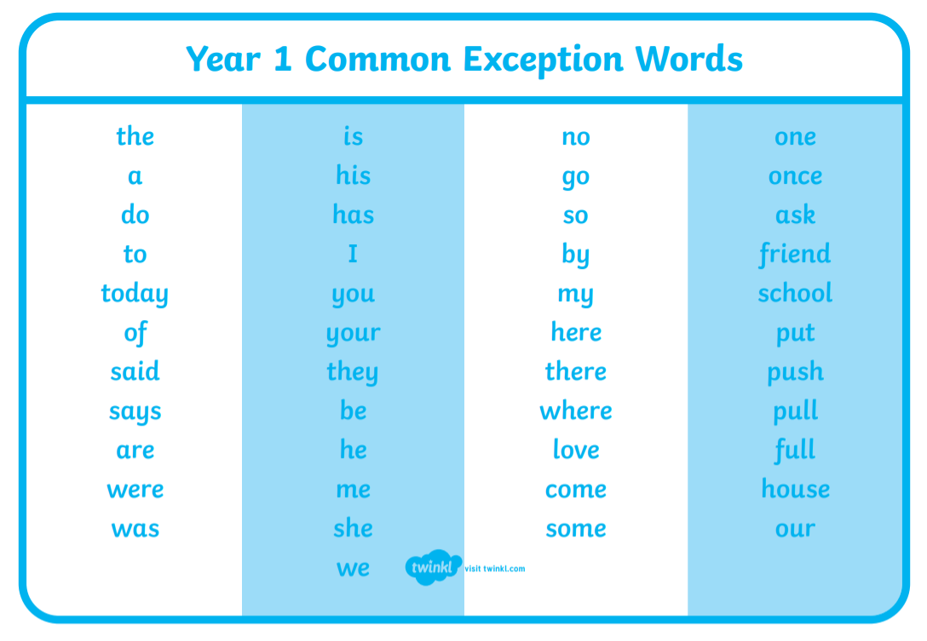
KA

Slide 14
KA
Handwriting
We follow the letter-join handwriting scheme.
It is a cursive script with leads in and out which helps when they start to join their letters in Year 2.

Slide 15
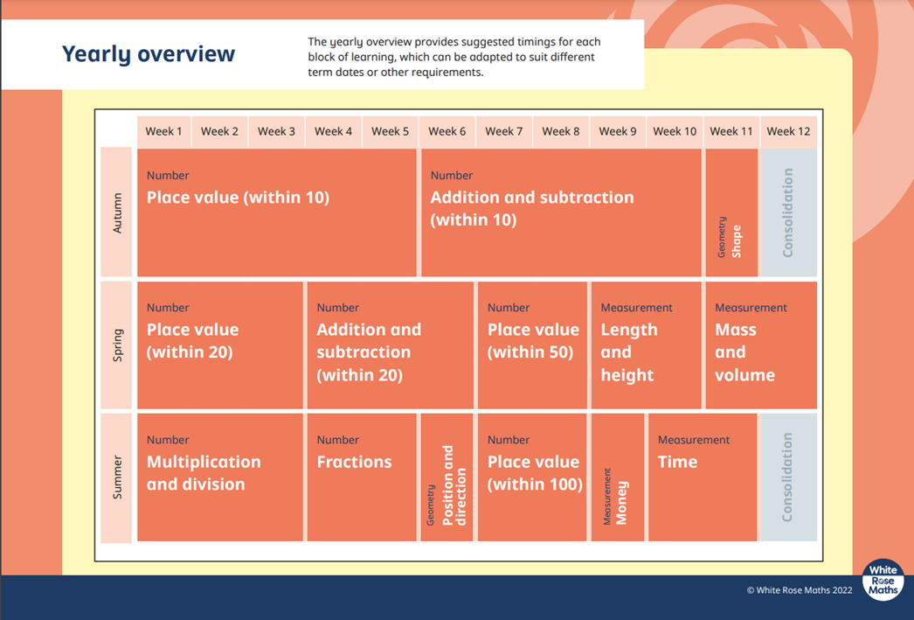
Maths
ES
We follow the White Rose maths scheme which aims to develop both mathematical fluency and the ability to problem solve and reason.

Slide 16
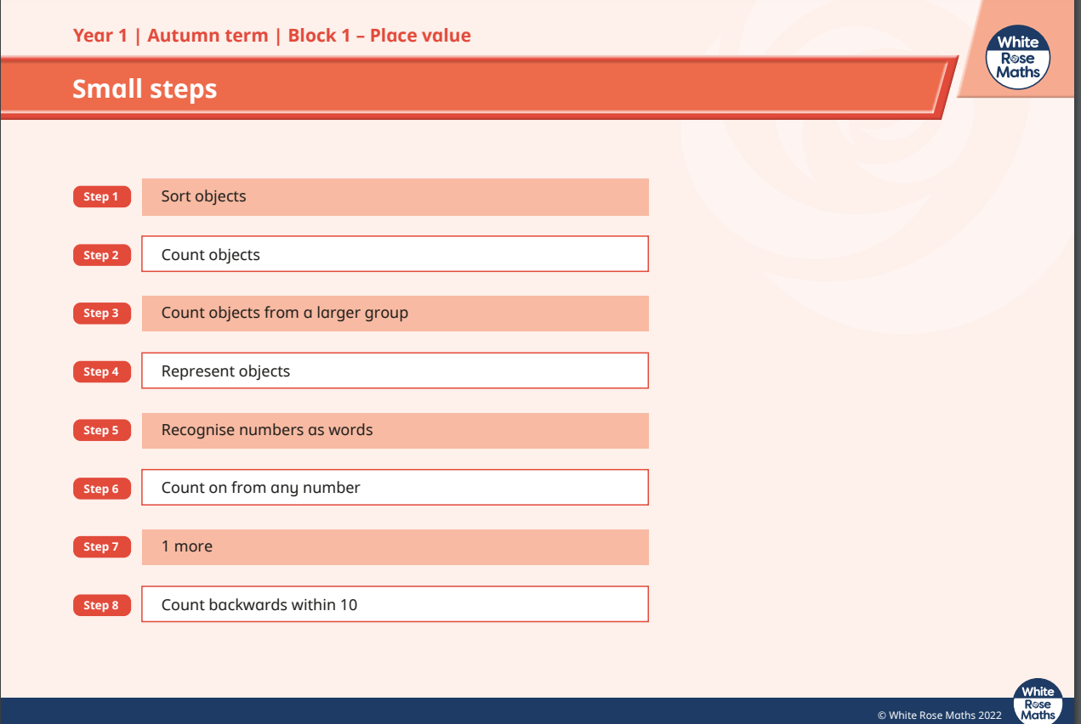
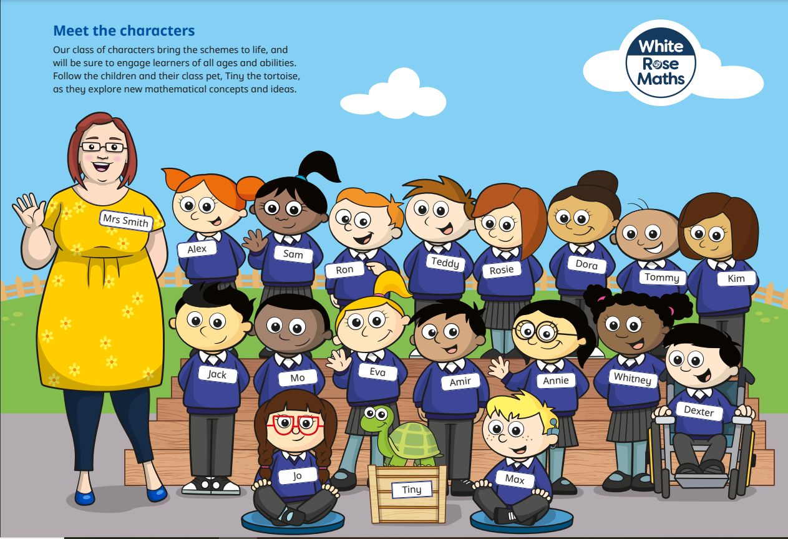
Maths
ES

Slide 17
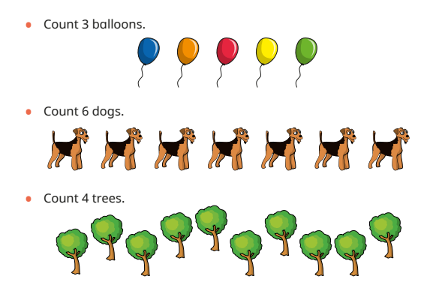
Maths
ES
Fluency

Slide 18
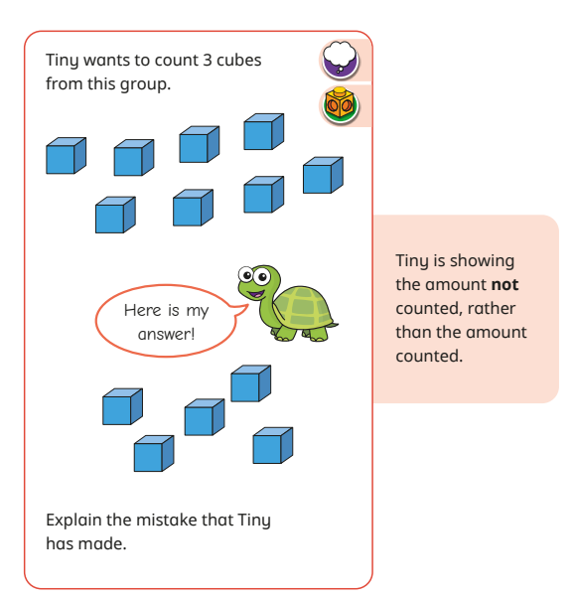
Maths
ES
Problem solving and reasoning

Slide 19
Home Learning
KA
Speaking and listening | Daily | Talk to your child and ask questions about their day at school. Ask your child to share 3 facts they have learnt.
Reading | Daily 10 Minutes | Sharing a reading book, talking about what they have read, asking questions encourage your child to use their skills of inference and deduction.
Phonics | Daily 5 minutes | Practise and applying recognition of new phonemes.
Handwriting | Weekly 10 minutes | Practising correct letter formation in preparation for using joined handwriting. This will be sent home on a Friday.
Maths | Weekly 15 minutes | A shared activity supporting and consolidating topics taught in class. This will be sent home on a Friday.
Home learning does not need to be returned to school once completed.

Slide 20
KA
Curriculum enhancement
During the year the children will participate in a variety of activities to enhance the National Curriculum. In line with current guidance, hopefully these will include:
Working with food.
Forest school
Trips that compliment the curriculum.
Drama workshop – Perform
Visitors offering drama, music, dance and science experiences.
Membership for Chertsey museum to enhance our history.
Book week
Feeling good week

Slide 21
Thank you for coming!

